Slide 1

You are very hungry, and go to restaurant and choose to eat a meal there.
What will you order???

Slide 2

Did you order….
or

Slide 3


Slide 4
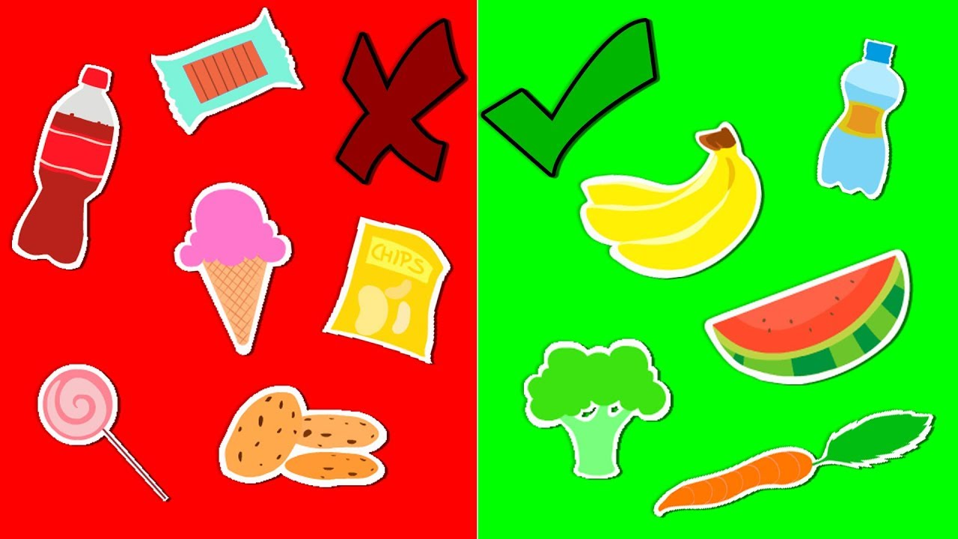
What is a junk food?
Junk foods have little or no health benefits.
Ingredients used are unhealthy.
Junk food contains high level of sugar, salt and fats.

Slide 5

Why should we avoid junk food?
Lack of energy – Junk foods do not provide nutritional value.
Poor concentration – It makes you feel drowsy.
Obesity - weight gain due to excessive amount of body fat

Slide 6

Examples of junk food
Hamburger
Carbonated drink (coke, sprite etc.)
French fries
Ice cream
Muffins
Cakes
Pasta
Noodles
You can eat junk occasionally

Slide 7
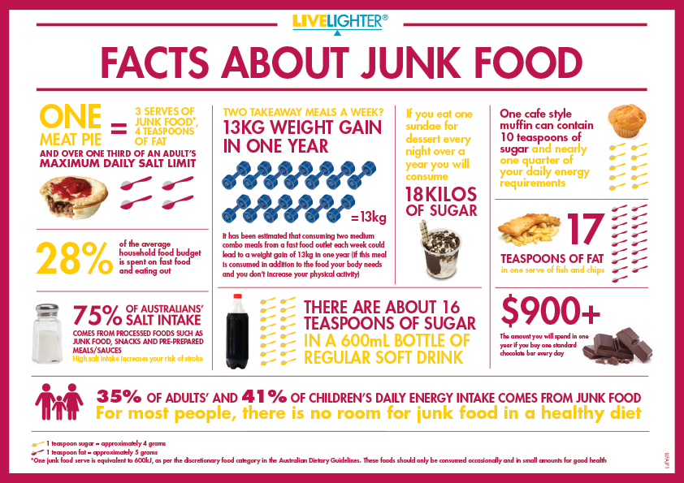

Slide 8
What is a healthy food?
Nutritional value
Gives energy
Maintains and improves your health
Contains proteins, carbohydrates, vitamins and fats

Slide 9


Slide 10
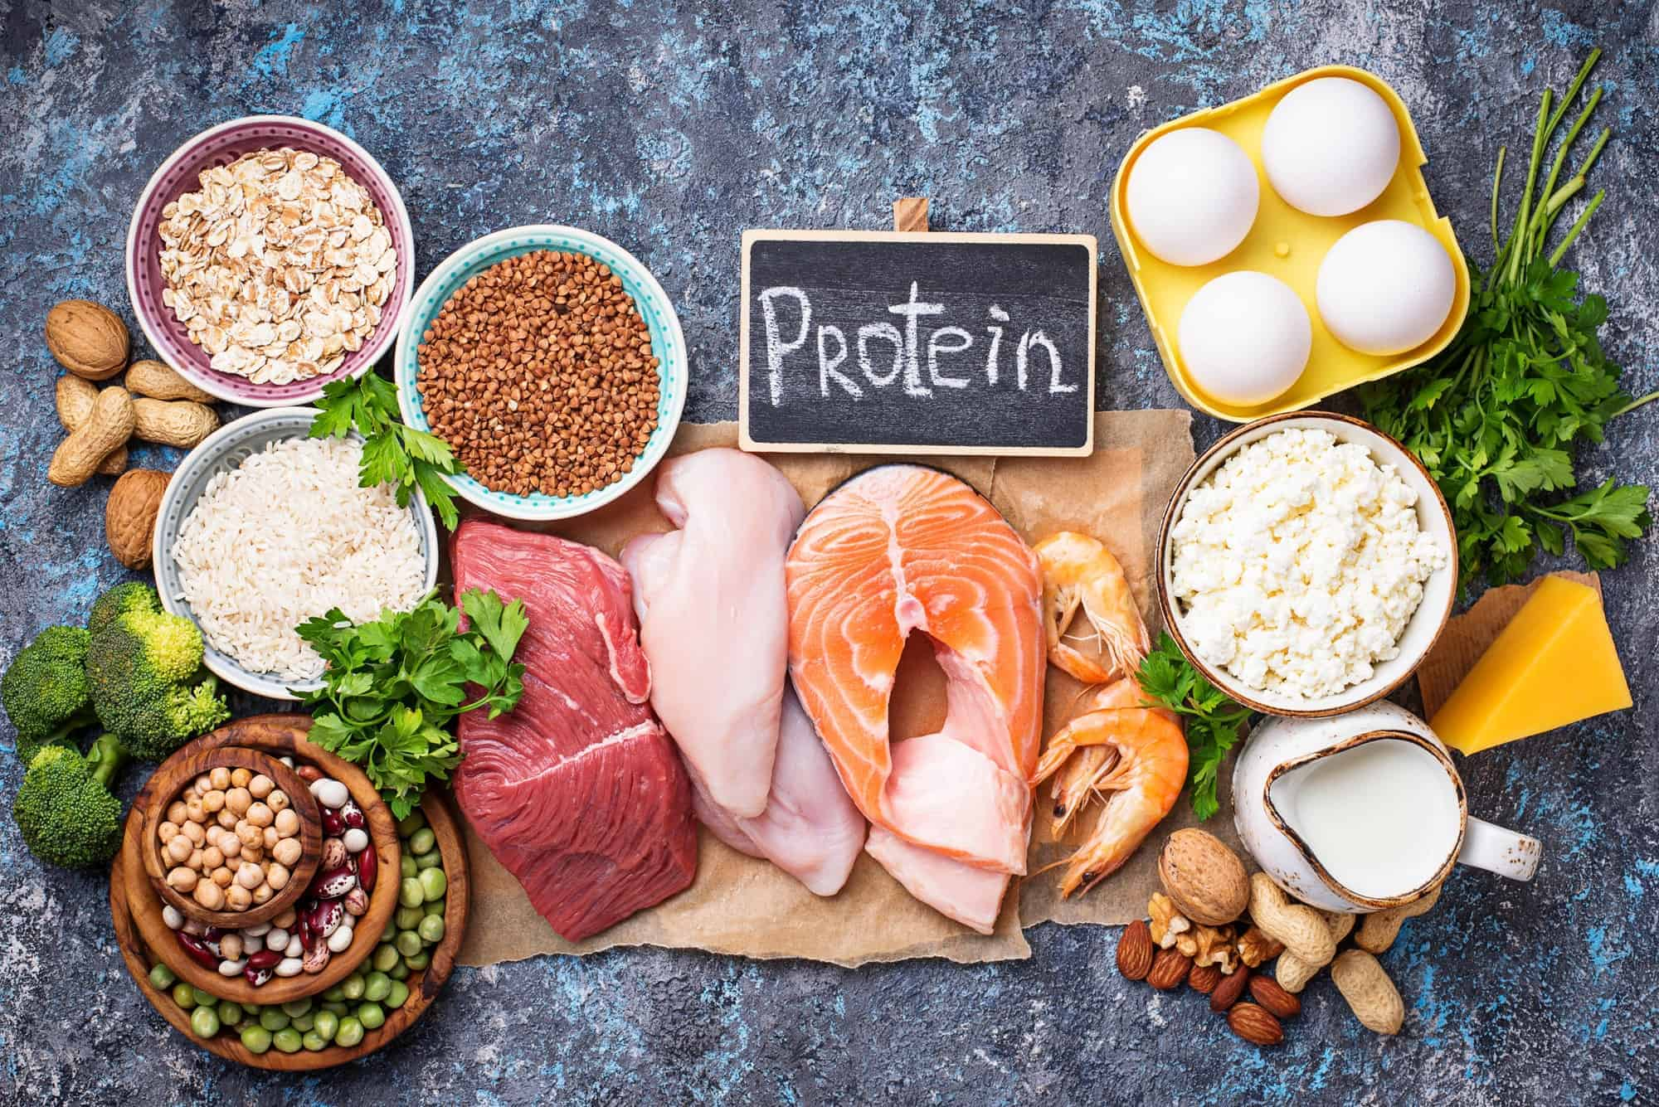

Slide 11


Slide 12


Slide 13

To stay healthy add more fruits in your diet

Slide 14
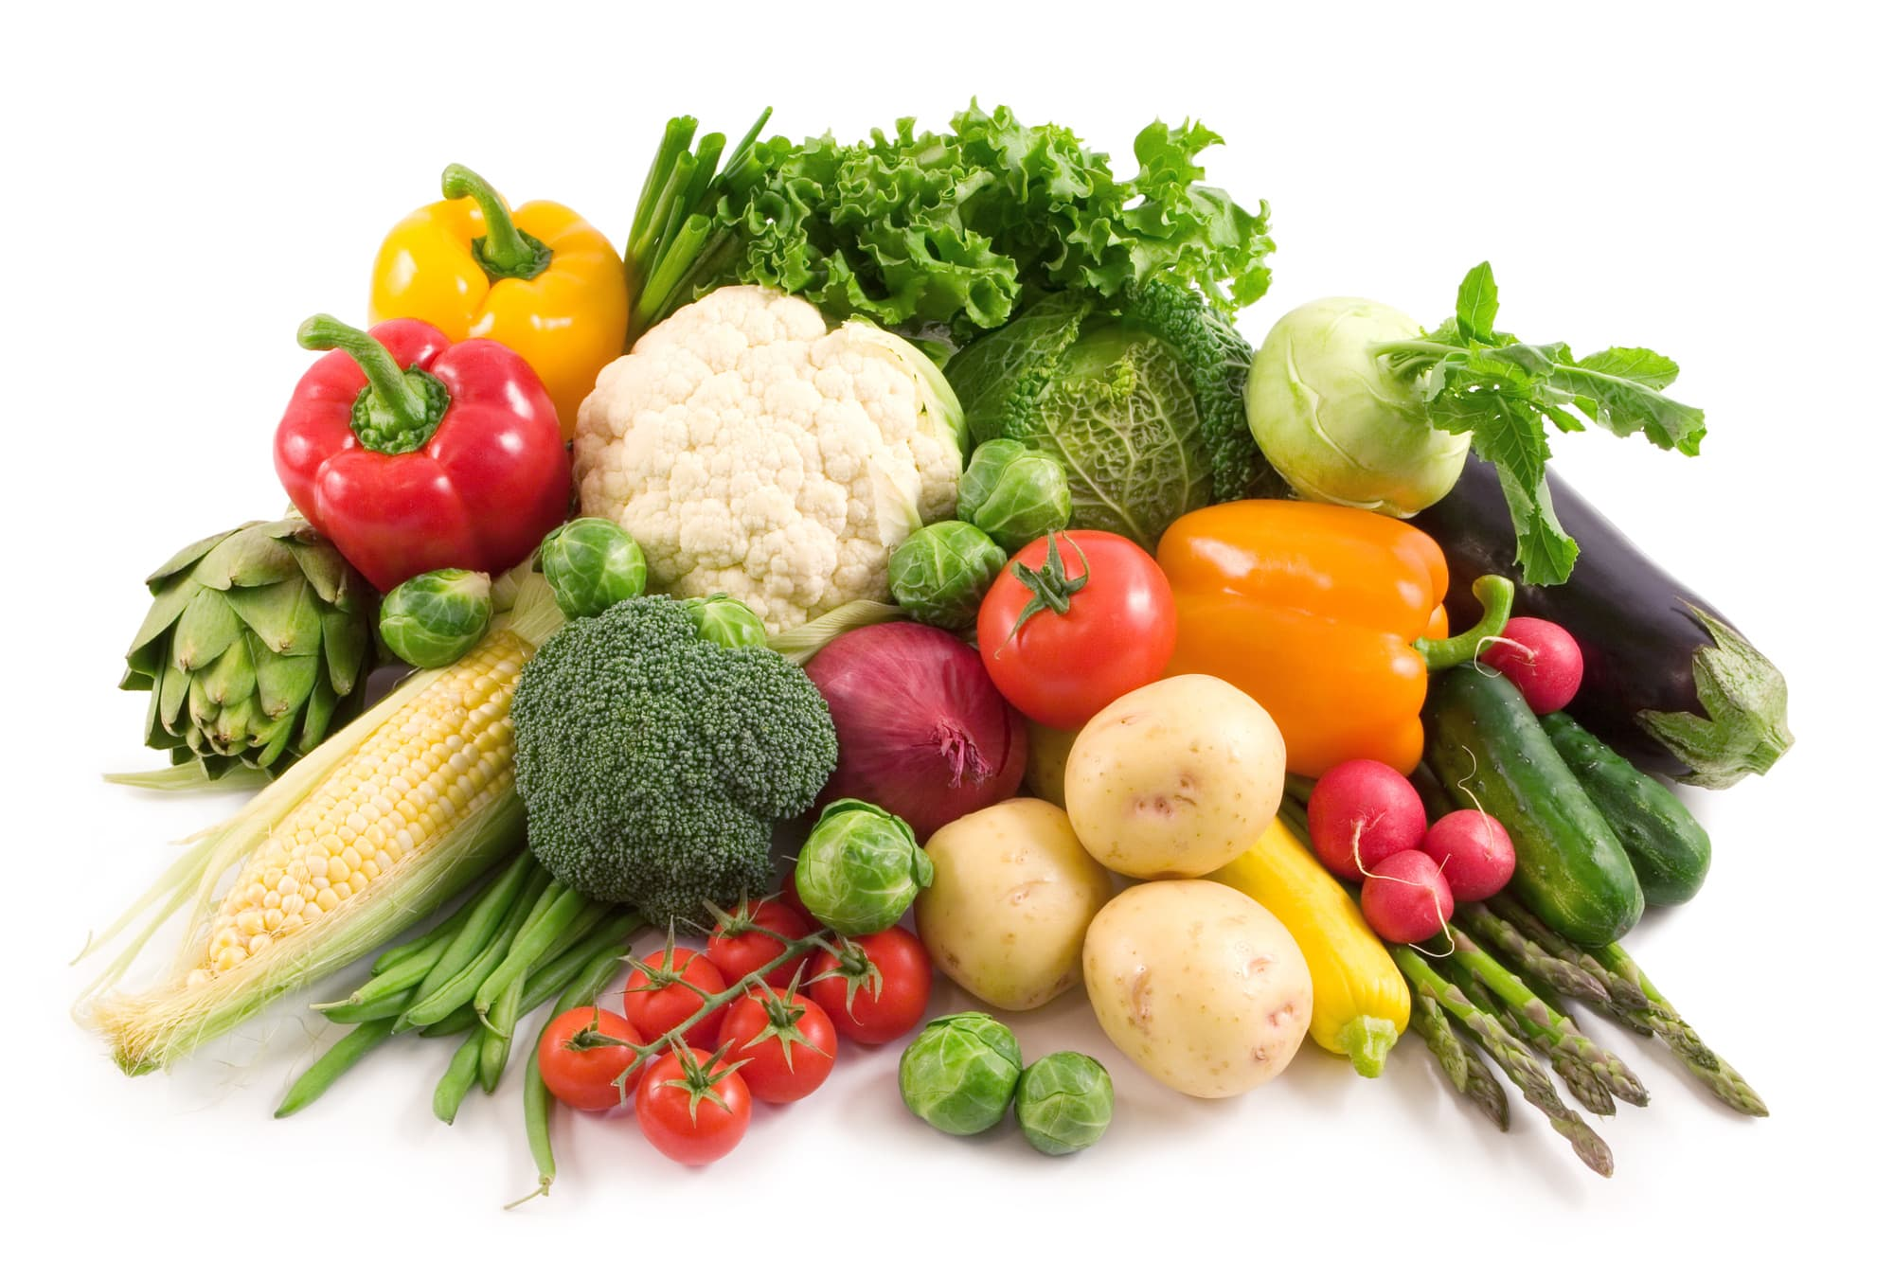
To stay healthy add more vegetables in your diet

Slide 15
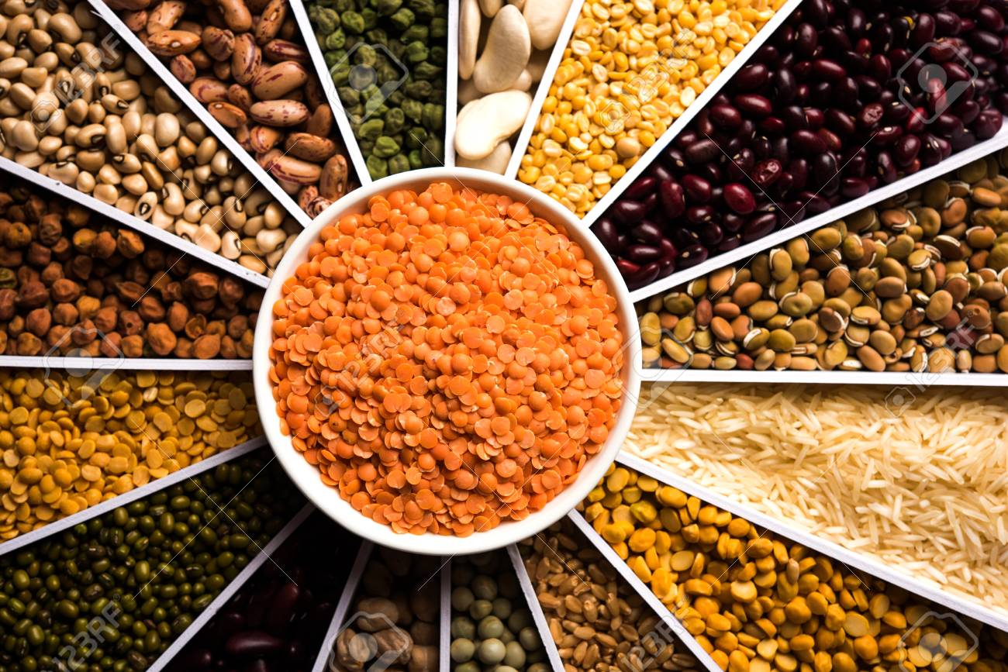
To stay healthy add more grains in your diet

Slide 16
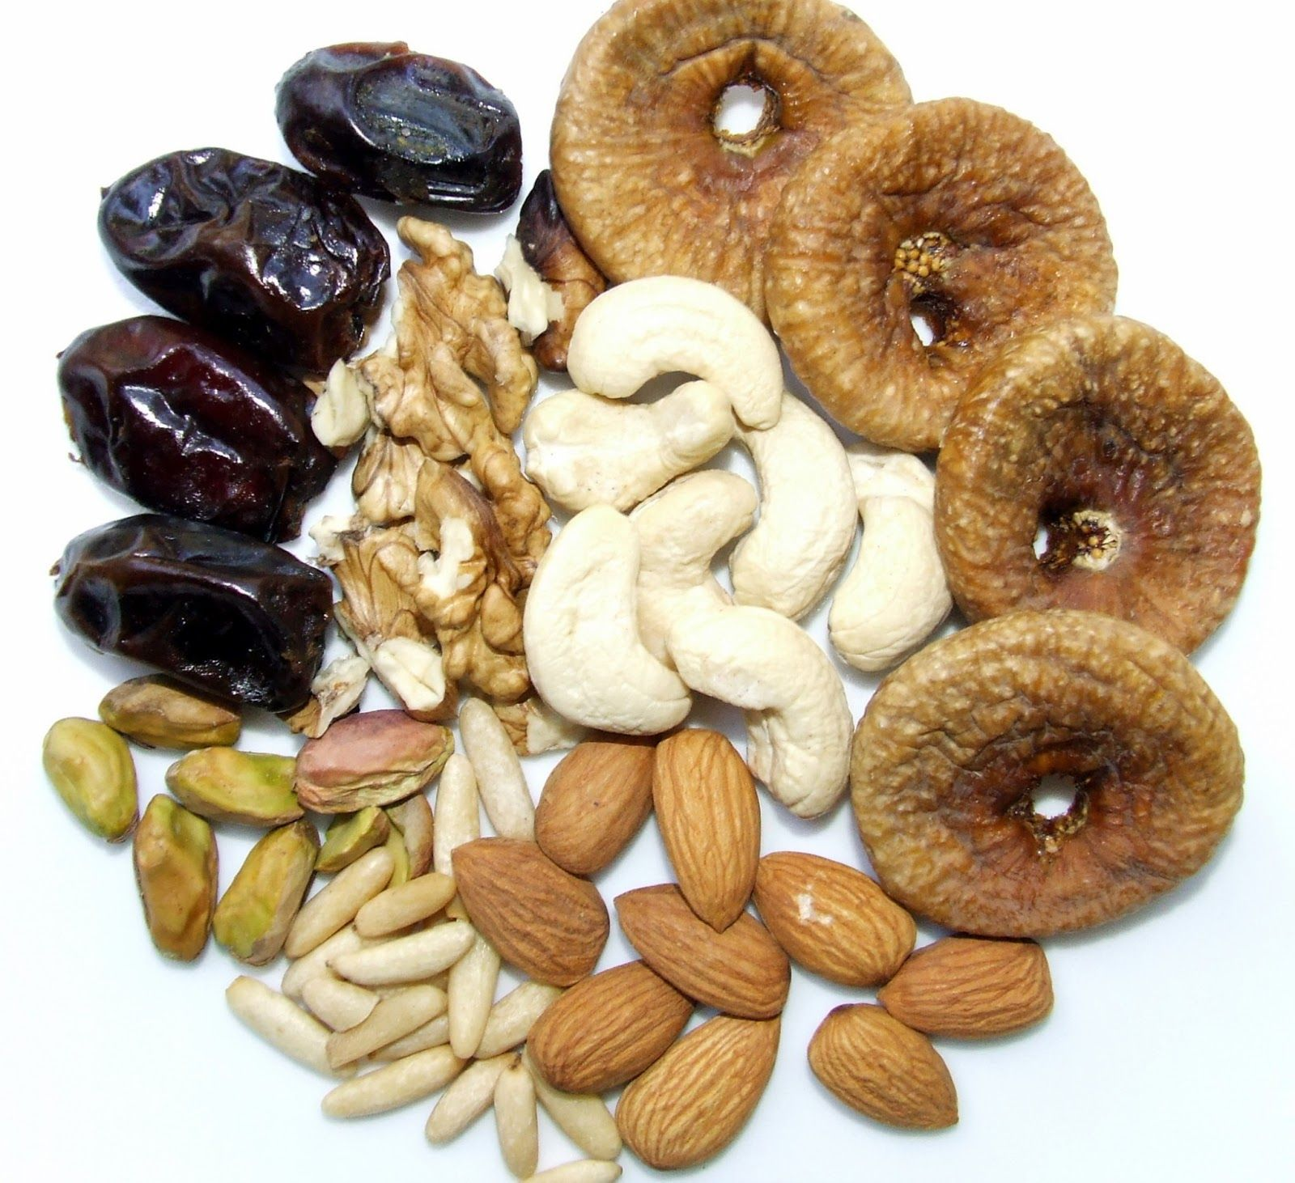
To stay healthy add more nuts and dry fruits in your diet

Slide 17
Identify the picture and tell if its healthy food or junk food

Slide 18

junk food

Slide 19

healthy food

Slide 20
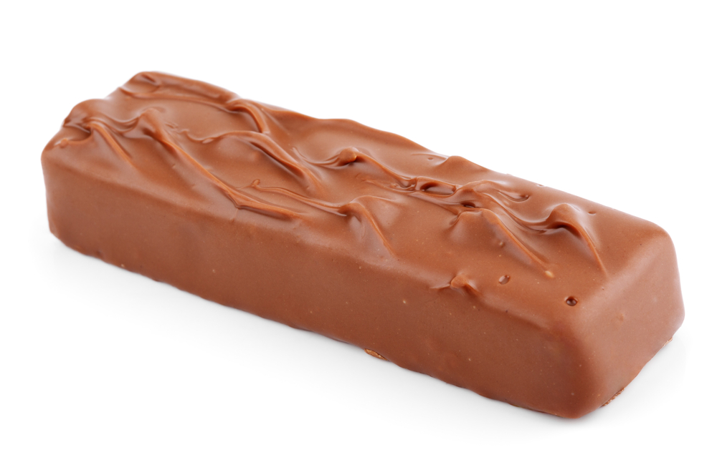
junk food

Slide 21
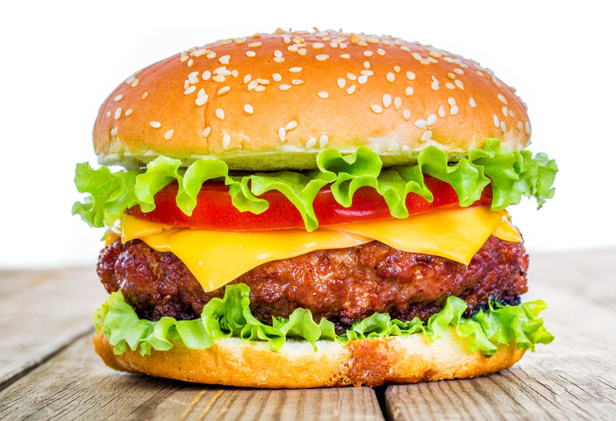
junk food

Slide 22
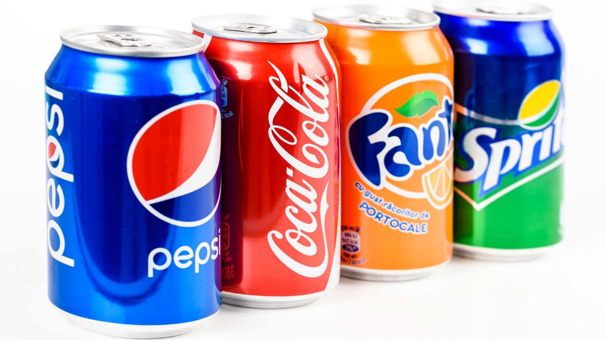
junk food

Slide 23
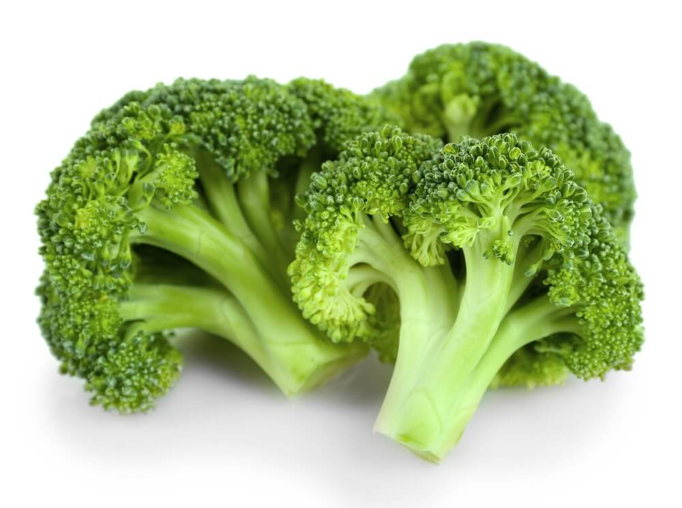
healthy food

Slide 24
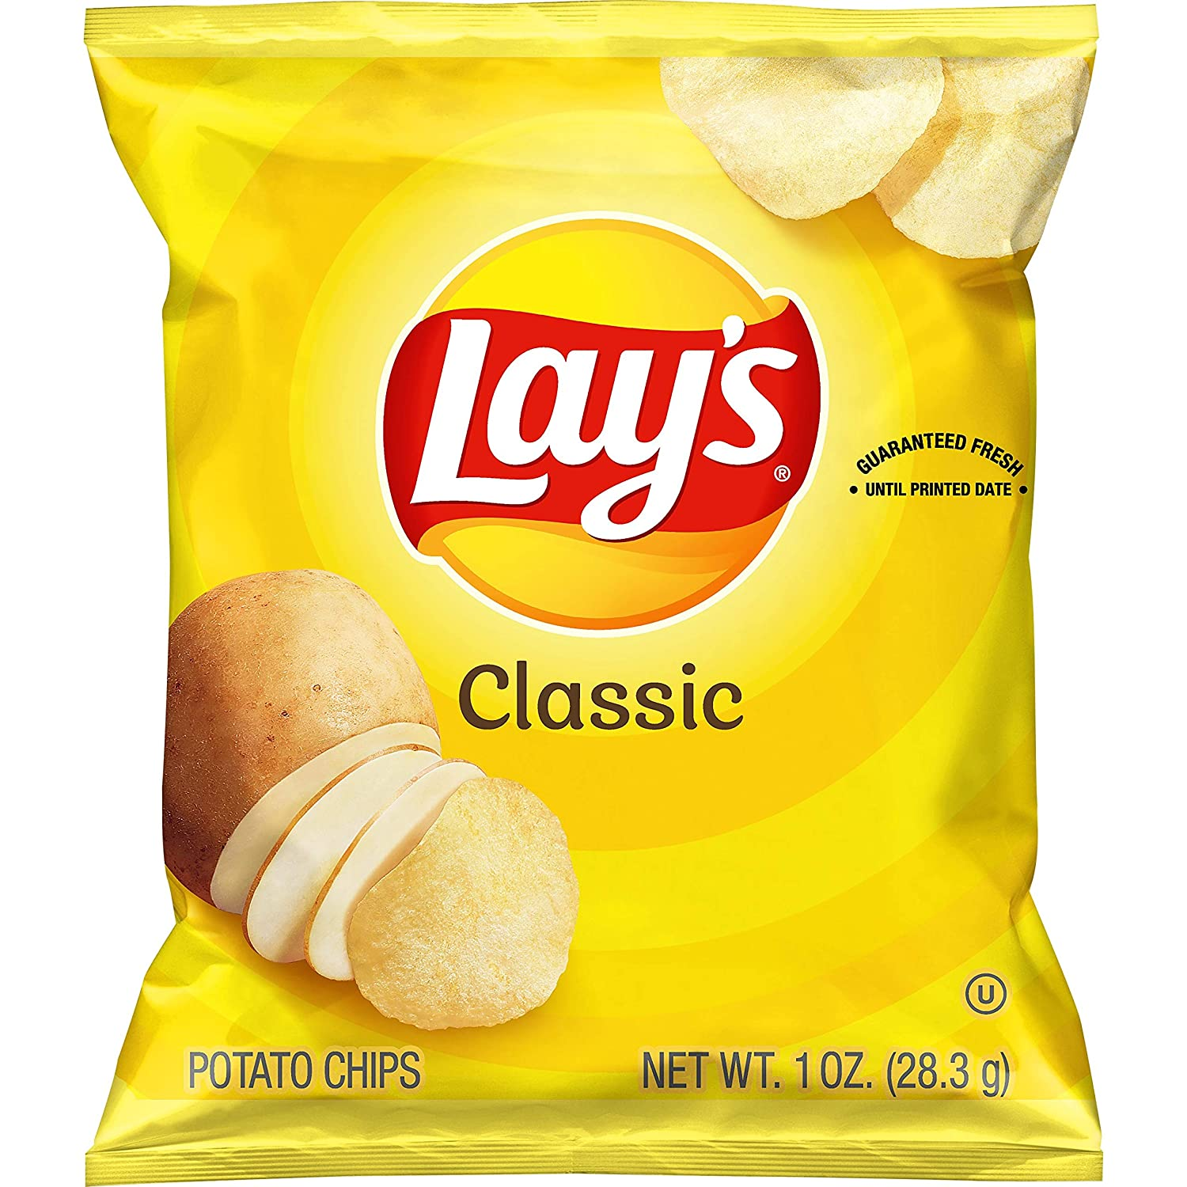
junk food

Slide 25
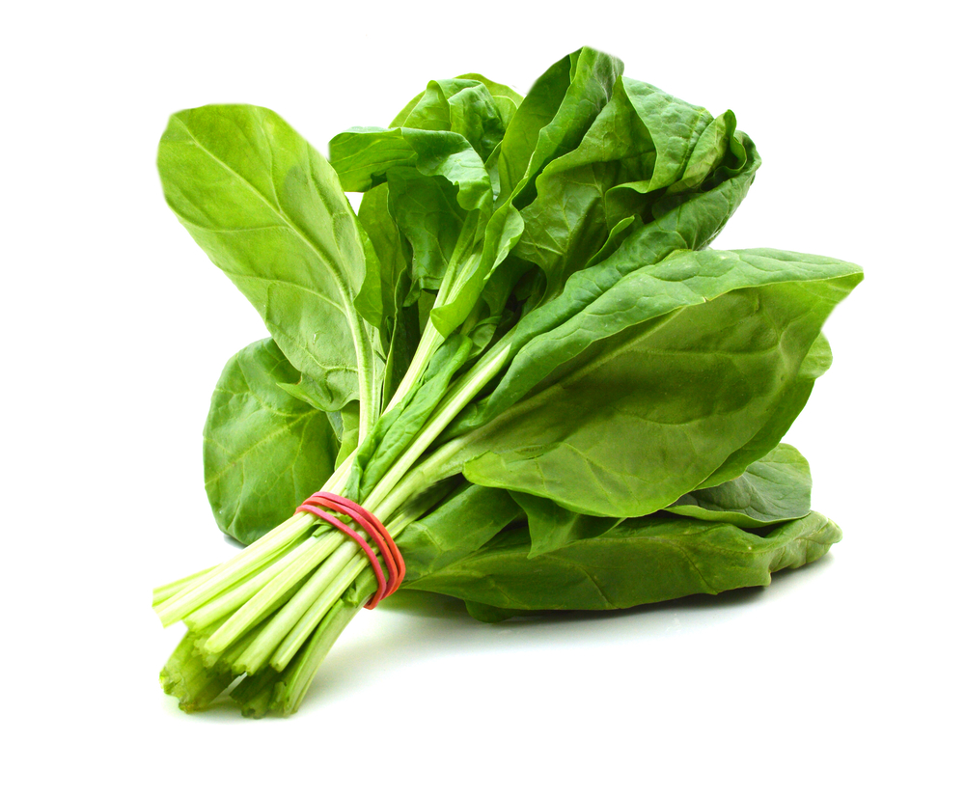
healthy food

Slide 26
Riddle Time!!!
Guess the food items

Slide 27

If you go see a movie You have to get some of this And then add butter or salt For a taste that’s simply bliss

Slide 28

This is something yellow But it is not a light It is a citrus fruit That’s a flavor in Sprite

Slide 29

This is a stem That can be red, white or green It can make you cry a lot Even though it is not mean

Slide 30

In a bowl you use a spoon On a cone you give a lick This frozen dairy dessert Many flavors you can pick

Slide 31

I’m something that is sticky I’m something that is sweet I’m made by more than one bee I’m something that you eat

Slide 32
Guess the name of the fruit!

Slide 33
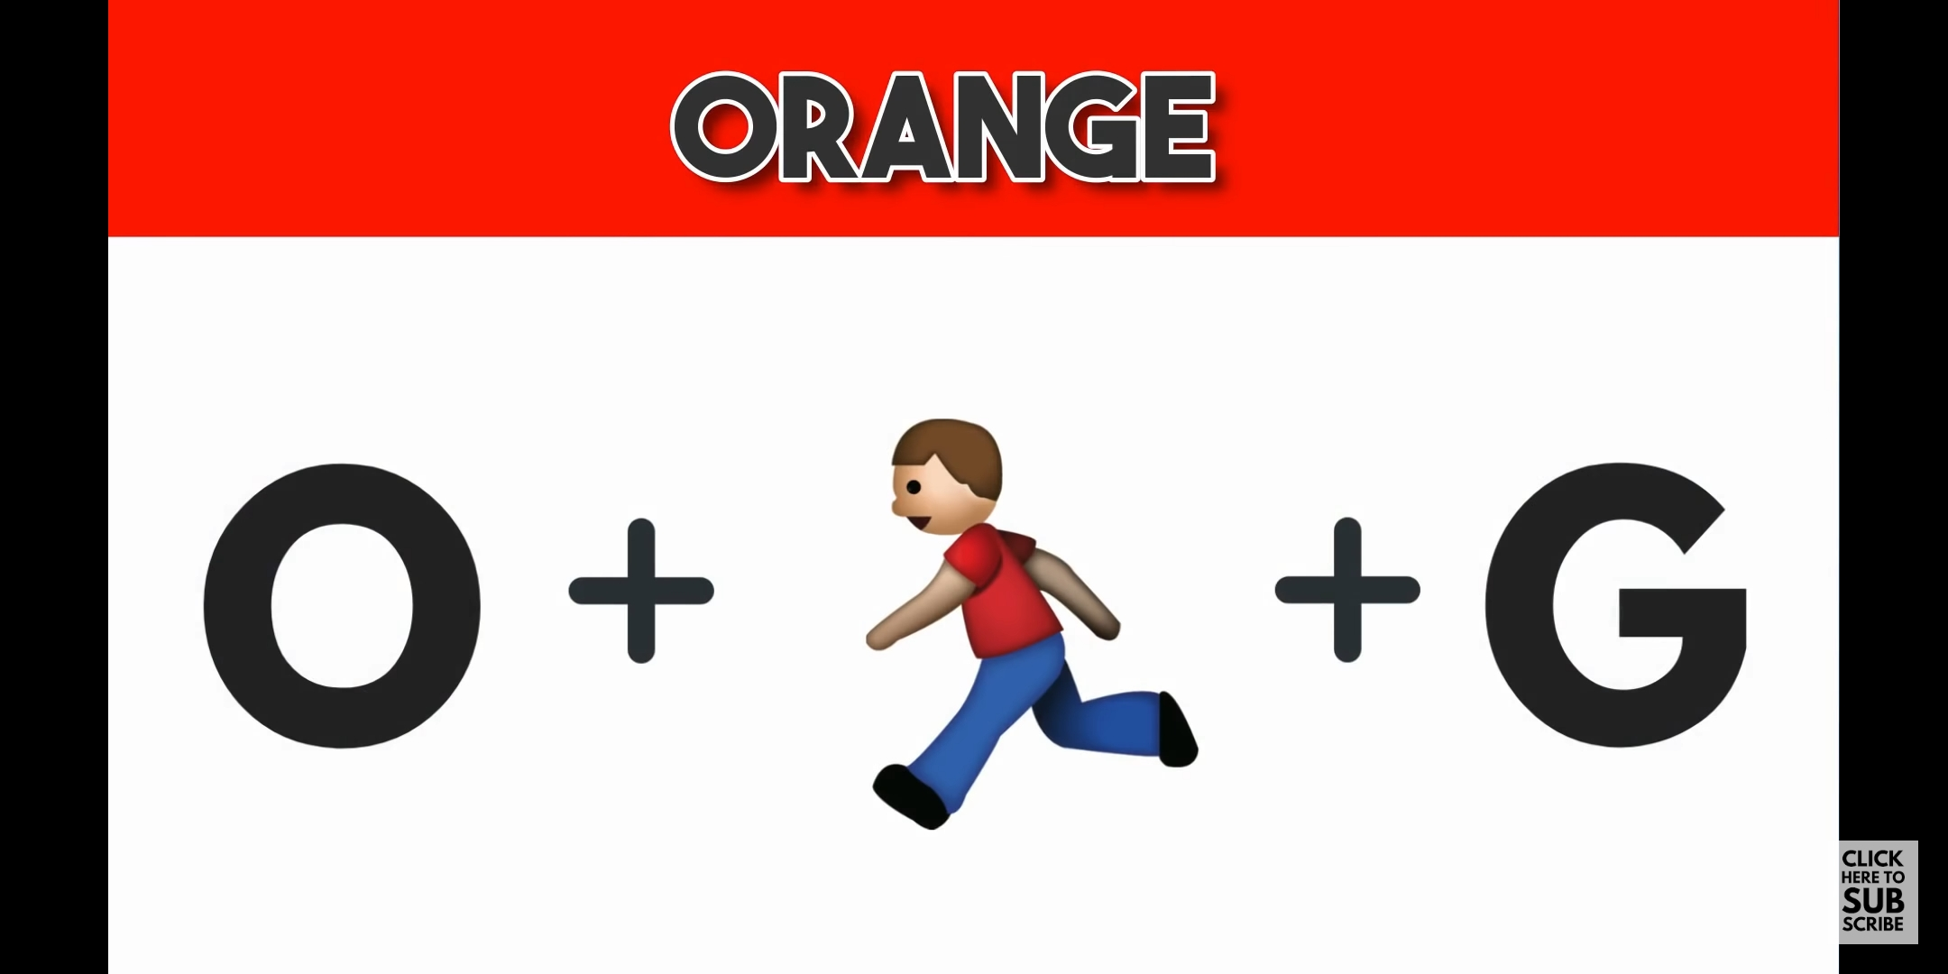

Slide 34


Slide 35


Slide 36


Slide 37
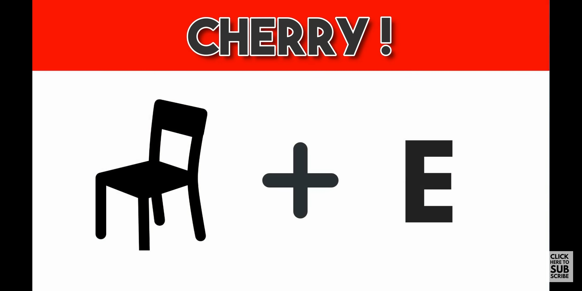

Slide 38
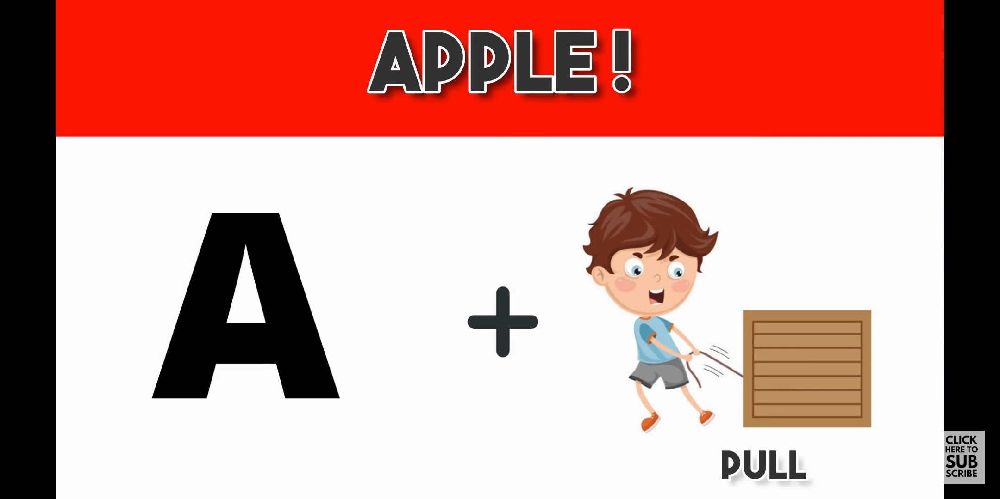

Slide 39

EVS 1A workbook
Complete page 96, 97, 99

